Slide 1


ANALYSIS AND PREDICTION OF HOUSEHOLD ELECTRICITY PRICE CONSUMPTION USING TIME SERIES ANALYSIS AND DATA HANDLING
Presented by:
NAME - ANIKET MITRA
M.Sc GEOINFORMATICS
SYMBIOSIS INSTITUTE OF GEOINFORMATICS

Slide 2
INTRODUCTION
Electricity Price refers to the cost you pay per unit of electricity used, typically measured in kilowatt-hours (kWh). The price can vary widely depending on your location, energy source (e.g., fossil fuels, renewables), and even the time of day you use the electricity (time-of-use billing).
Electricity Consumption: This refers to the amount of electricity your household uses, measured in kWh. I have predicted the household electricity price consumption using from 2006-2010 based on time. Generating different analytical techniques i have predicted the modeling techniques and performing the time series analysis and machine learning algorithms to visualize the outcomes.

Slide 3
DATASETS AND DATA HANDLING
The datasets contains -
1. Date: Date of the electricity consumption recording.
2. Time: Time of the electricity consumption recording.
3. Global_active_power: Total active power consumed by the household.
4. Global_reactive_power: Total reactive power consumed by the household.
5. Voltage: Voltage level during the electricity consumption period.
6. Global_intensity: Total current intensity consumed by the household.
7. Sub_metering_1: Electricity consumption in sub-metering 1 (e.g., kitchen).
8. Sub_metering_2: Electricity consumption in sub-metering 2 (e.g., laundry).
9. Sub_metering_3: Electricity consumption in sub-metering 3 (e.g., water heater).

Slide 4
OBJECTIVES OF THE STUDY -
Clean and preprocess the dataset, handling any missing values or outlier
Visualize the relationships between different features to gain insights.
Explore the creation of new features that might enhance prediction accuracy.
Visualize and interpret the predictions to identify potential consumption patterns.

Slide 5
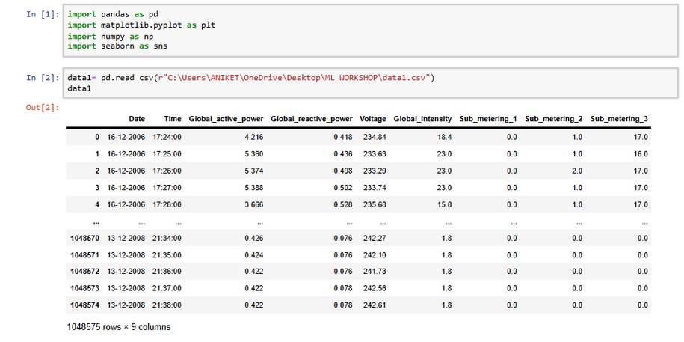
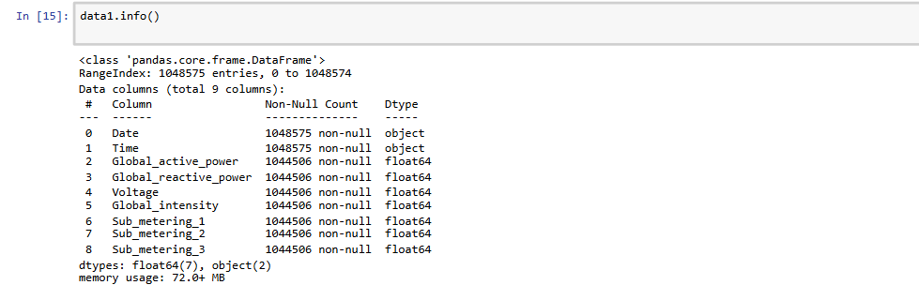
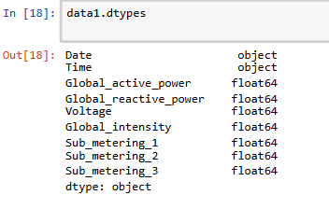
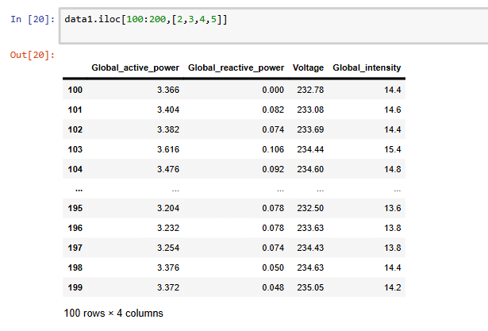
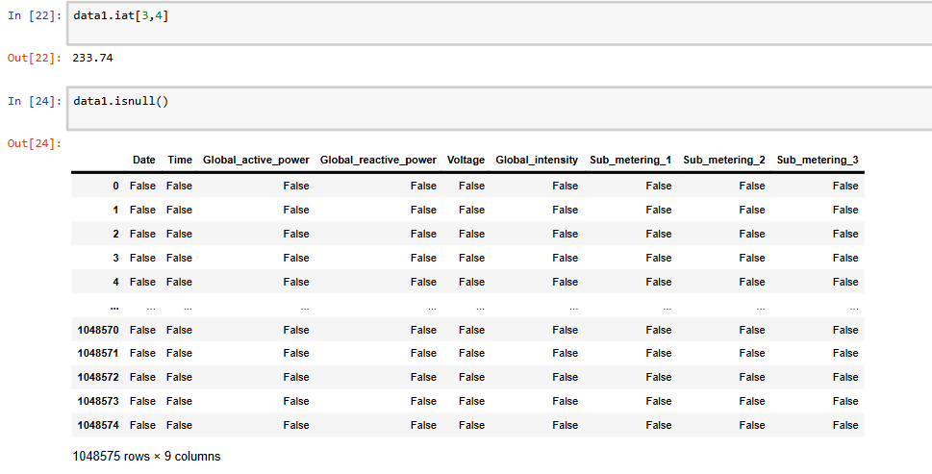
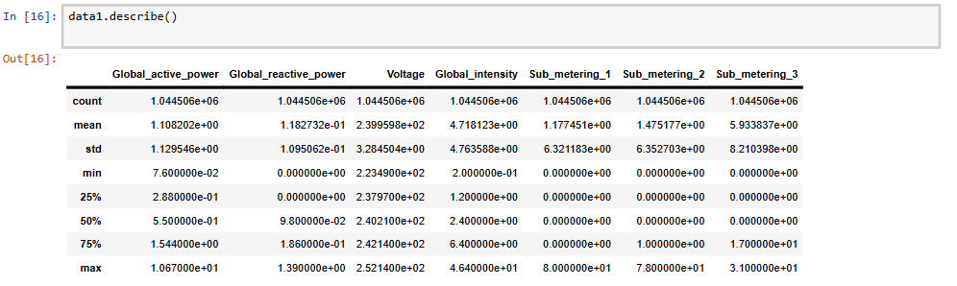
EXPLORATORY DATA ANALYSIS

Slide 6
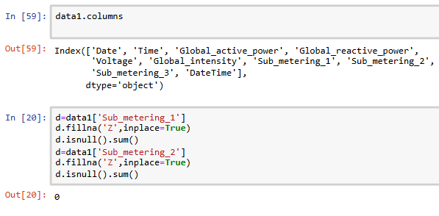
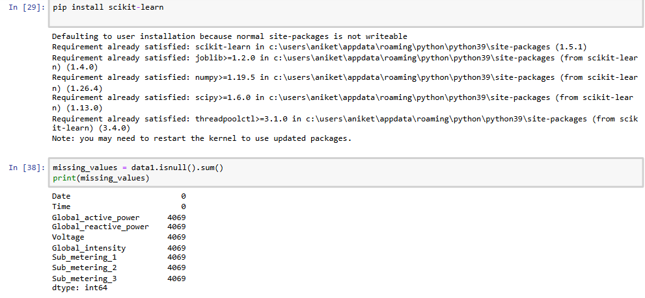
HANDLING MISSING VALUES

Slide 7
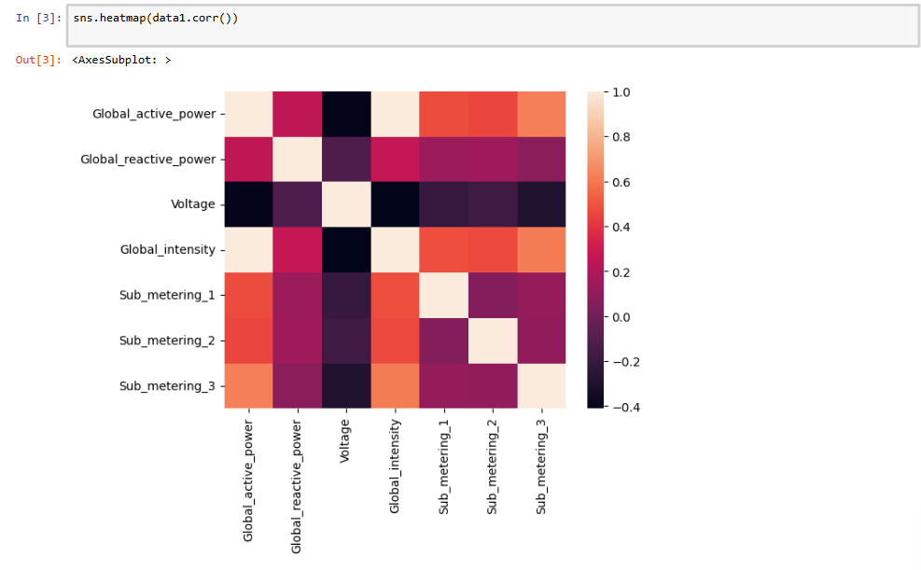
PREPARE A CORRELATION MATRIX OF HOUSEHOLD ELECTRICITY CONSUMPTION
Positive correlations are shown in red towards the bottom right corner of the matrix. Stronger positive correlations are bright red, while weaker correlations are a lighter shade of red.
Negative correlations are shown in blue towards the top left corner of the matrix. Stronger negative correlations are dark blue, while weaker correlations are a lighter shade of blue.
A value of 1 indicates a perfect positive correlation, while -1 indicates a perfect negative correlation.
A value of 0 indicates no correlation.

Slide 8
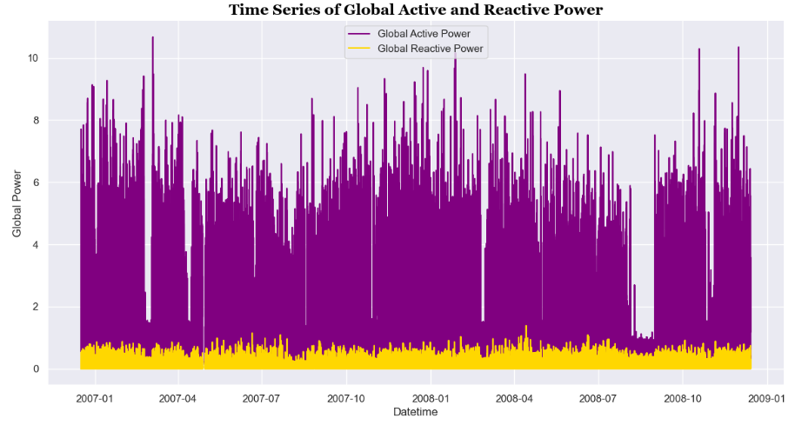
TIME SERIES ANALYSIS USING LINE GRAPH
Global active power appears to be on an increasing trend over the ten year period.
Global reactive power appears to be on a decreasing trend over the ten year period.

Slide 9
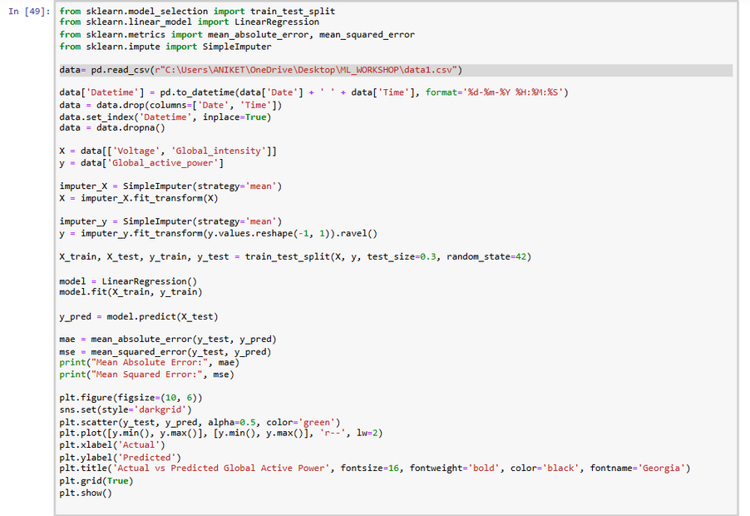
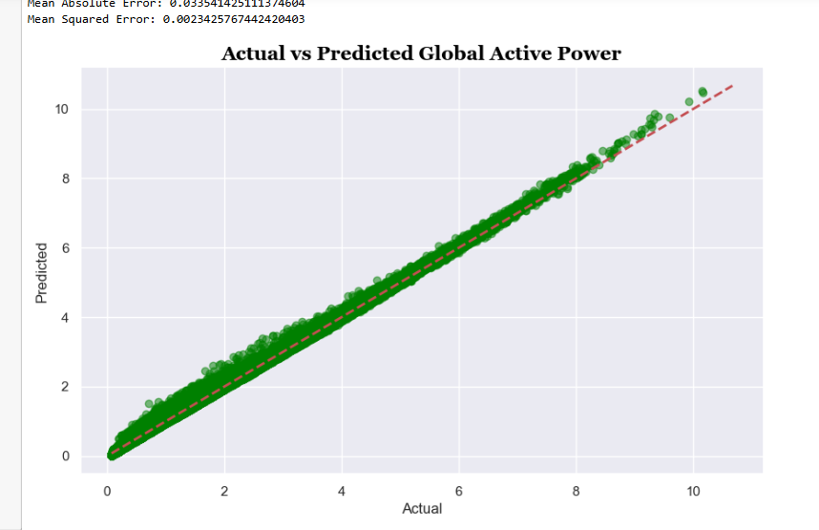
TIME SERIES ANALYSIS USING LINEAR REGRESSION TECHNIQUES

Slide 10
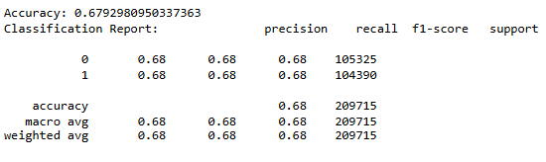
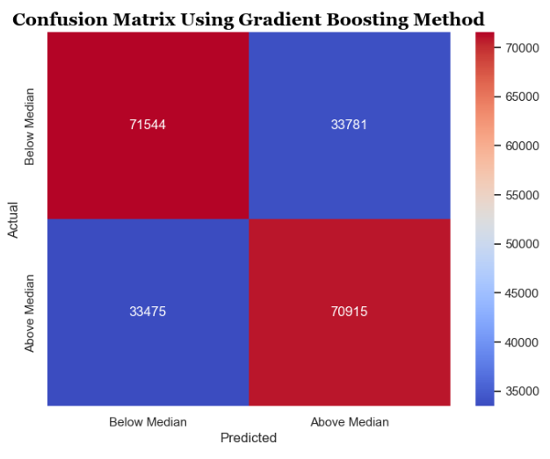
ANALYSIS USING GRADIENT BOOSTING METHOD
It shows the accuracy, precision, and recall for two classes (likely 0 and 1).
Accuracy: 0.68, which means the model classified 68% of the data points correctly.
Precision: 0.68, which means of the data points the model classified as class 1, 68% were actually class 1.
Recall: 0.68, which means of the actual class 1 data points, the model classified 68% of them correctly.
The confusion matrix shows the number of correct and incorrect predictions made by the model for two classes. The rows represent the actual classes, and the columns represent the predicted classes. For example, looking at the bottom right corner, 45,000 data points were actually in the class “Below Median” and the model correctly predicted this.

Slide 11
CONCLUSION AND FUTURE OUTCOMES
Predicting the future of electricity price consumption is complex, but here's a breakdown of some factors that will likely influence it:
Consumption:
Increase: Global electricity demand is expected to rise at an average of 3.4% annually through 2026, driven by factors like population growth, economic development, and electrification of industries and transportation. Sectors like data centers and artificial intelligence could see surging power consumption.
Decrease: Energy efficiency improvements in appliances and buildings, and a shift towards renewable energy sources, could moderate consumption growth.
Prices:
Increase: Rising demand, along with potential fuel cost fluctuations (e.g., natural gas), could put upward pressure on prices. Upgrading and maintaining aging grids could also add costs.
Decrease: Increased use of cheaper renewable energy sources like solar and wind could stabilize or even decrease prices in some areas. Technological advancements in energy storage could also help smooth out price fluctuations.
Uncertainties:
Policy changes: Government policies promoting renewable energy or energy efficiency can significantly impact prices and consumption.
Extreme weather: Climate change could lead to more frequent heat waves and cold snaps, increasing demand for cooling and heating, which could impact prices.

